Slide 1


Titolo presentazione sottotitolo
Wireless and Mobile Propagation
Milano, XX mese 20XX
Prof. Michele D’Amico
Politecnico di Milano
2025

Slide 2
Private Mobile Radio Network Design
Iman Javaheri
Peyman Javaheri
Hamed Lotfalizadeh

Slide 3
Outline
Introduction
Network Architecture
VHF Side Design (Repeaters and Terminals)
Microwave Network Design
Repeater Placement & Coverage
Link Analysis & Coverage
Conclusion
Future Work

Slide 4
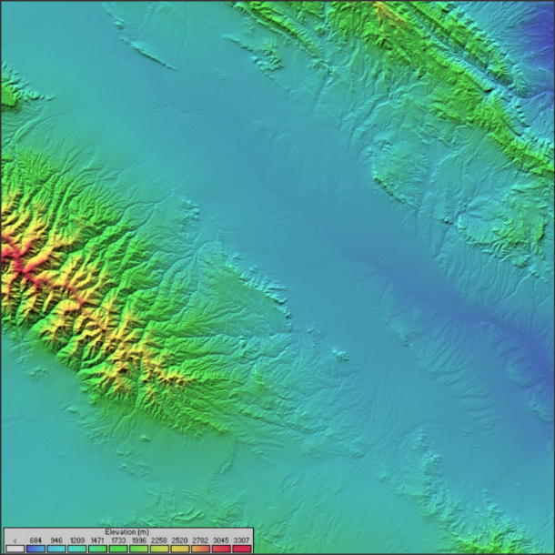
Introduction
PMR for emergency/security services
Area: 100 km x 100 km, centered on Mashhad, Iran
Objective: High coverage, low cost, reliable links

Slide 5
Project Goals
Minimize repeater count
Maximize coverage with LOS placement
Ensure microwave connectivity between repeaters
Simulate and validate with RadioMobile

Slide 6
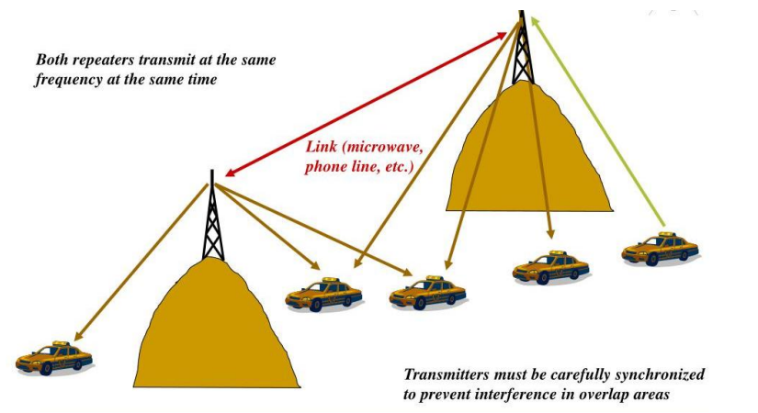
Network Architecture
Dual-network:
VHF (158 MHz) for users ↔ repeaters
Microwave (10–15 GHz) for repeater ↔ repeater

Slide 7
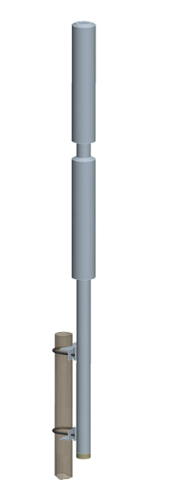
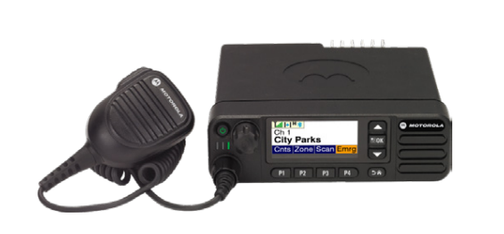

Equipment Specs (VHF Side)
Repeaters: Motorola SLR5500 (50 W, 0.22 µV sensitivity)
Terminals: Motorola DM4000e (35 W, 0.3 µV sensitivity)
Antennas: Omni 5 dBi (repeater), 0 dBi (vehicle)
Repeater
Terminal
Repeater Antenna

Slide 8
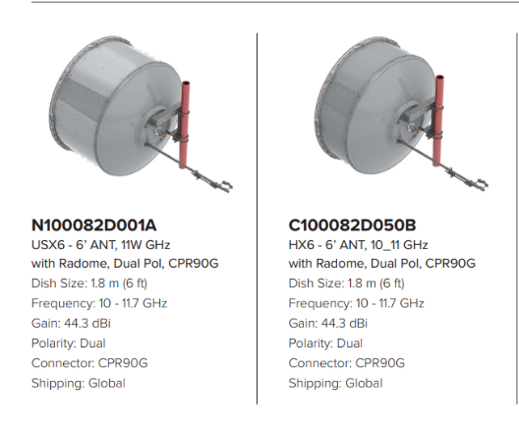
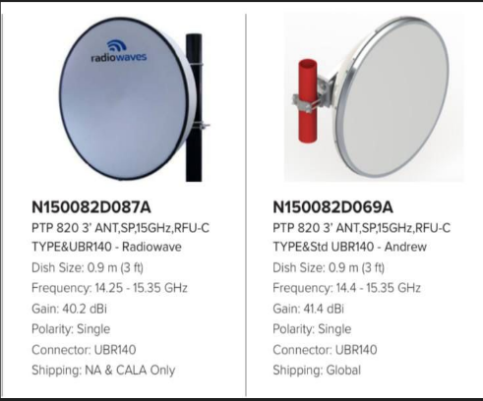
Microwave Network Design
P2P microwave links between repeaters
10 GHz: 25–70 km, 44.3 dBi gain antenna,10 m tower
15 GHz: 10–25 km, 41.4 dBi

Slide 9
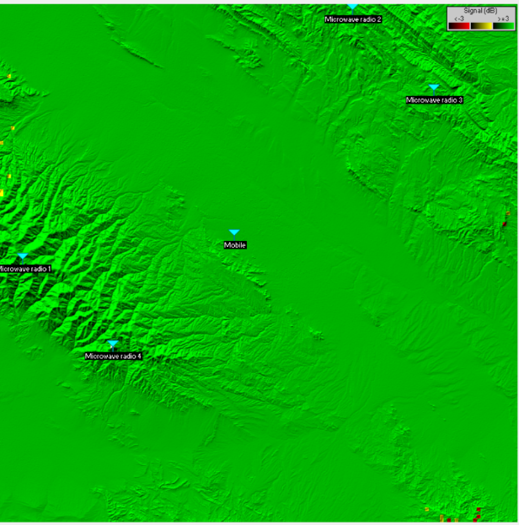
Repeater Placement Strategy
High elevation (>2000 m) for better LOS
4 repeaters placed manually

Slide 10
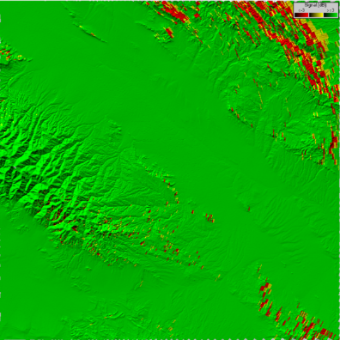
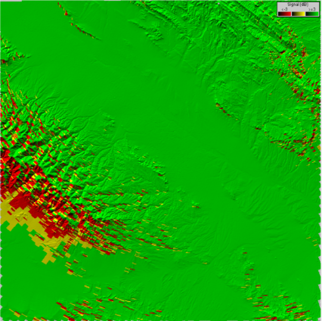
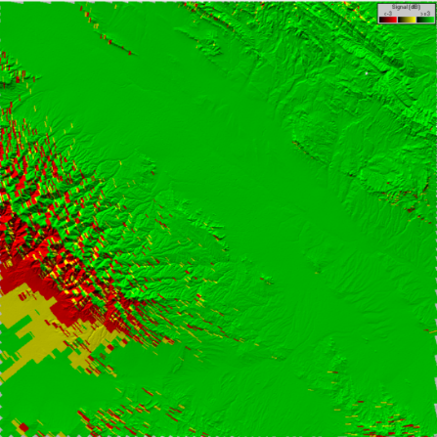
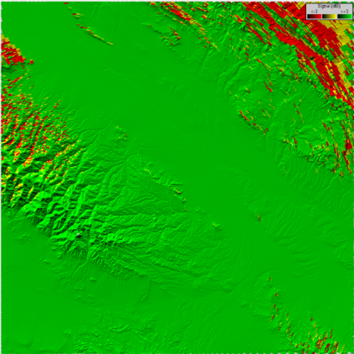
Individual Coverage Plots
RPTR 1
RPTR 2
RPTR 3
RPTR 4

Slide 11
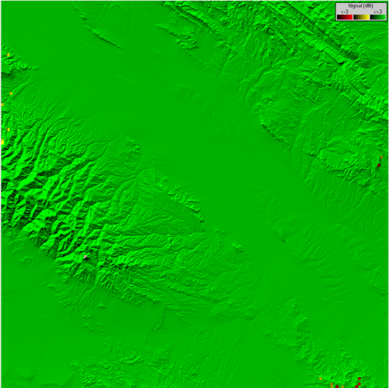
Combined Coverage
Achieved 99.9% coverage

Slide 12
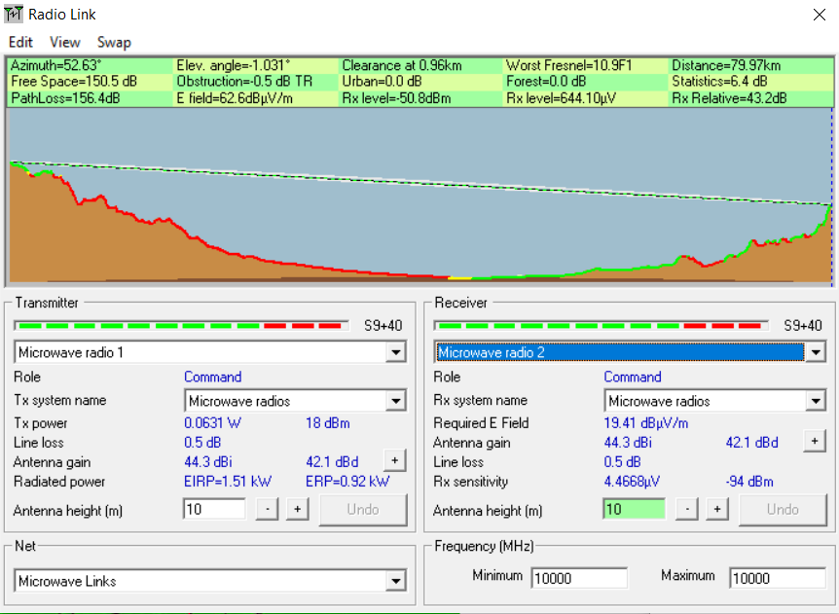
Link Analysis
clear LoS
RPTR 1 – RPTR 2

Slide 13
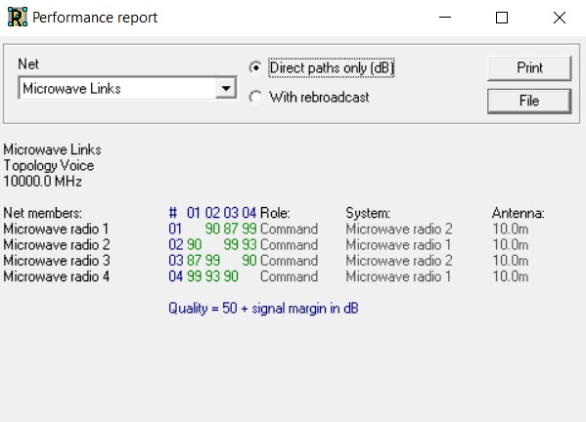
Network Quality Report
reflects the strength of the connection between pairs of repeaters
all links > 50 → strong and reliable

Slide 14
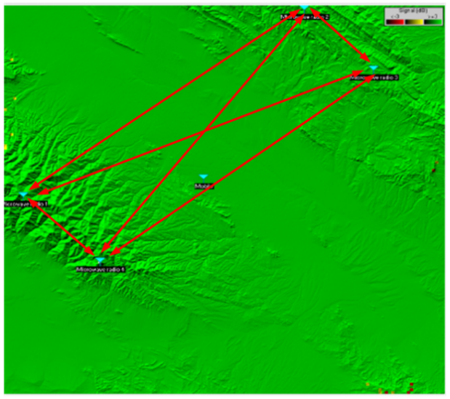
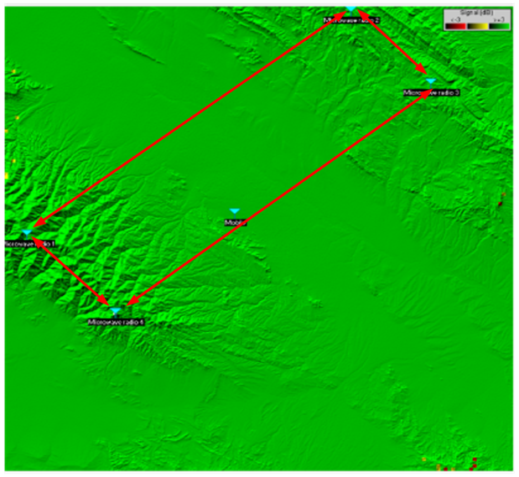
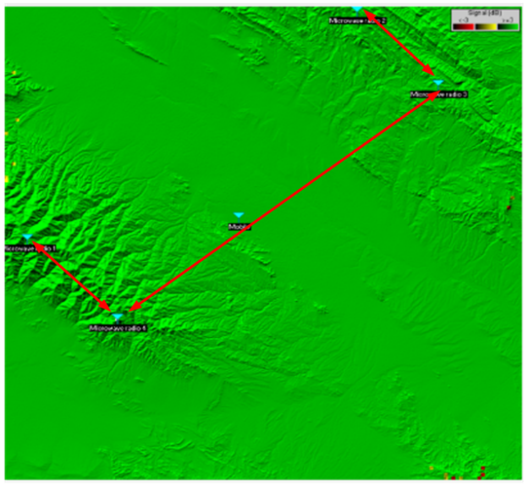
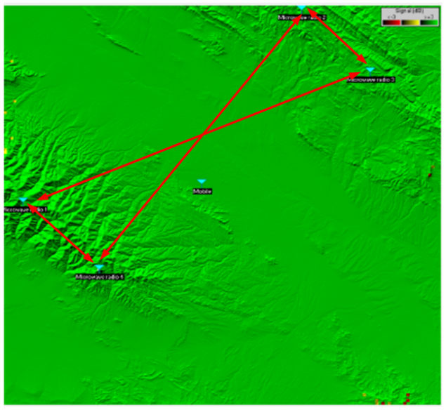
Link Topologies
a. Full Mesh
b. Ring I
c. Line
d. Ring II

Slide 15
Conclusion and Future Work
4-repeaters = 99.9% area coverage
Reliable microwave interconnect
Efficient, cost-effective PMR design
Future work:
Green energy: solar-powered repeaters

Slide 16
Thank you for your attention!

